Slide 1

Distributed & Cloud Computing
Welcome
Class: BS(CS)-VII
Sukkur IBA University – Kandhkot Campus
Week - 02
Lecture – 03 & 04
Your Facilitator, Adil Khan

Slide 2
Recap
Computing
Distributed Computing
Cluster Computing
Grid Computing
Utility Computing

Slide 3
Cloud Computing

Slide 4
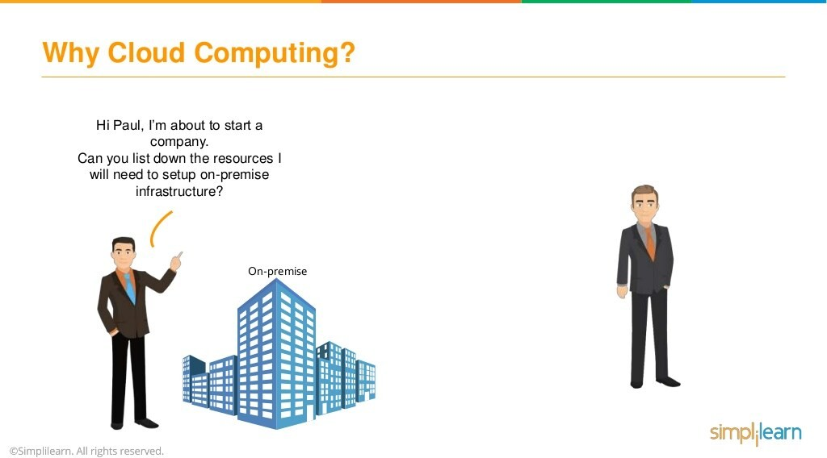
Why Cloud Computing?

Slide 5
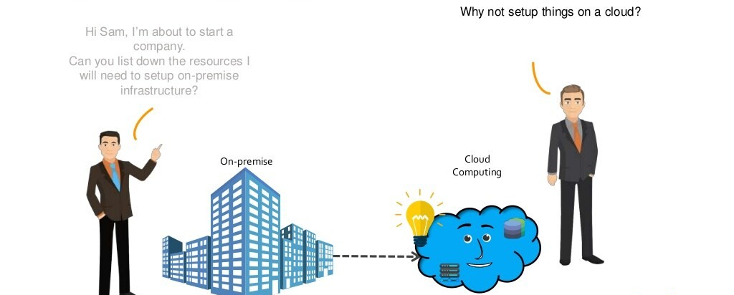
Why Cloud Computing?

Slide 6
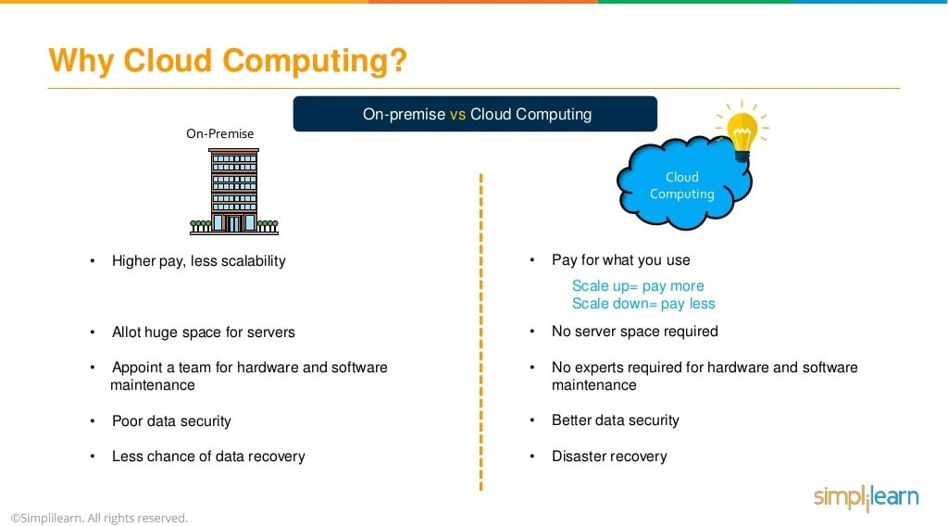
Why Cloud Computing?

Slide 7
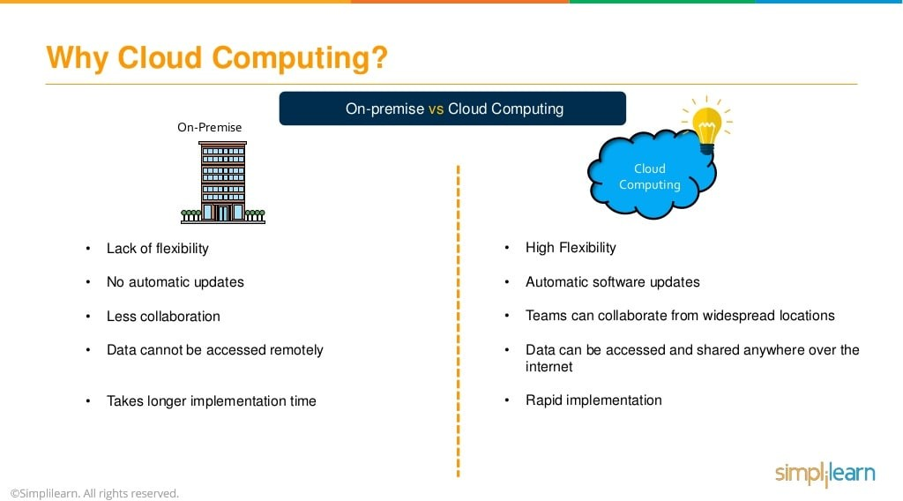
Why Cloud Computing?

Slide 8
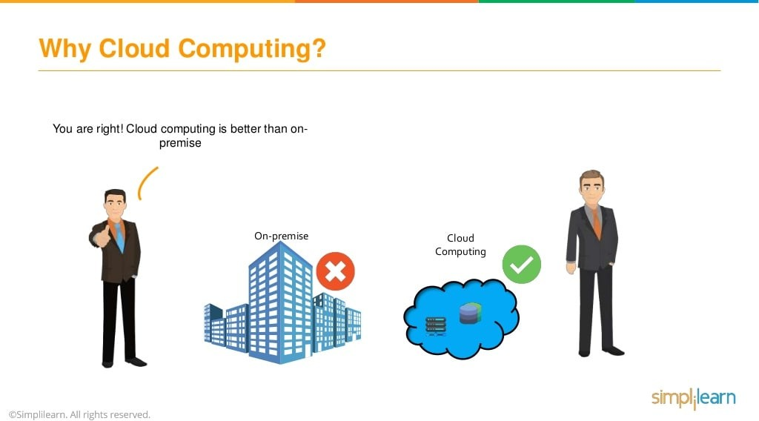
Why Cloud Computing?

Slide 9
Why Cloud Computing?
Pay As
You Go
Lower Total Cost of Ownership (TCO)
24x7 Support
Reliability, Scalability
Why Cloud Computing?
Device- & Location-Independent
Lower Capital Expenditure
Easy & Agile Deployment
Free Up Internal Resources
Utility Based
Highly Automated
Notes:
Notes:
Cloud computing is becoming very popular because they are flexible, reliable and cost effective. Items in this slide are categorized into one of these characteristics below:
Flexibility
Scale up and down to meet organization requirements and pay as you go
Charge for services on a fine grain level such as usage hours, Gbytes used, etc.
Easy and agile to deploy
Highly automated
Device- and location-independent
Reliability
24x7 support
Vendor responsible for hardware maintenance
Vendor responsible for software updates and maintenance for SaaS model
Cost
Reduce total cost of ownership (TCO)
Free up internal resources
Lower capital expenditure

Slide 10
What is Cloud Computing?
“The practice of using a network of remote servers hosted on the Internet to store, manage, and process data, rather than a local server or a personal computer.”
Oxford Dictionary
“The practice of storing regularly used computer data on multiple servers that can be accessed through the Internet.”
Webster Dictionary

Slide 11
What is Cloud Computing?
Cloud computing is a model for enabling ubiquitous, convenient, on-demand network access to a shared pool of configurable computing resources (e.g., networks, servers, storage, applications, and services) that can be rapidly provisioned and released with minimal management effort or service provider interaction. This cloud model is composed of five essential characteristics, three service models, and four deployment models.
National Institute of Standards and Technology
Notes:
Ubiquitous computing (pervasive computing) is a concept in software engineering and computer science where computing is made to appear anytime and everywhere. In contrast to desktop computing, ubiquitous computing can occur using any device, in any location, and in any format.

Slide 12
Evolution of Cloud Computing
Stage | Characteristics
Grid Computing | Solving large problems with parallel computing
Utility Computing | Computing resources offered as a metered service Late 1990s
Software as a Service | Subscription-based software accessed over the Internet Gained momentum after 2001
Cloud Computing | Next-generation datacenters with virtualization technology Full stack of service - IasS, PaaS, & SaaS
Order of Evolution

Slide 13
Key Enabling Technologies
Ubiquitous fast wide-area networks
Powerful and inexpensive servers
High-performance virtualization technology
Widespread Broadband
Hadoop
Linux Web Hosting
Microsoft SQL Server
Windows
Windows Server
Virtualization
Notes:
Notes:
Ubiquitous availability of fast wide-area networks
Widespread adoption of broadband access
Powerful and inexpensive server computers
Hardware cost has reduced exponentially over the past few decades
Multi-Core / Multi-thread
High-performance virtualization technology
Separates hardware from the operating system through the use of an abstraction layer (hypervisor)
Virtualization gives users the illusion of full access to a system of resources which may actually be shared by multiple users

Slide 14
Five Key Cloud Characteristics
On-demand self-service
Ubiquitous network access
Location-independent resource pooling
Rapid elasticity
Pay for what you use
Notes:
Notes:
On demand self-service:
This characteristic provides users with full control over their provisioned resources.
They should be able to power-up, increase, decrease, shutdown, or modify any other characteristics of their utilized resources without requiring assistance from the service provider.
Ubiquitous network access:
This characteristic refers to the widespread availability of broadband access to the Internet.
Further, the cloud should be accessible by various devices such as mobile phones, tablets, laptops, and workstations.
Location-independent resource pooling:
Cloud computing clients come from all over the world.
Service providers should be able to serve each of these clients equally well.
The quality of services or resources consumed by the client should not be dependent on the location of the client.
Service providers should be able to dynamically pool resources that may be geographically separated to create the illusion of a single unified service to the client.
Rapid elasticity:
The cloud service provider should be flexible in the provision of resources to meet the fluctuating demands of their customers.
Pay per use:
Expanding on the concept of utility computing, customers of cloud computing service providers are charged only for the resources they use.

Slide 15
Types of Cloud Computing

Slide 16
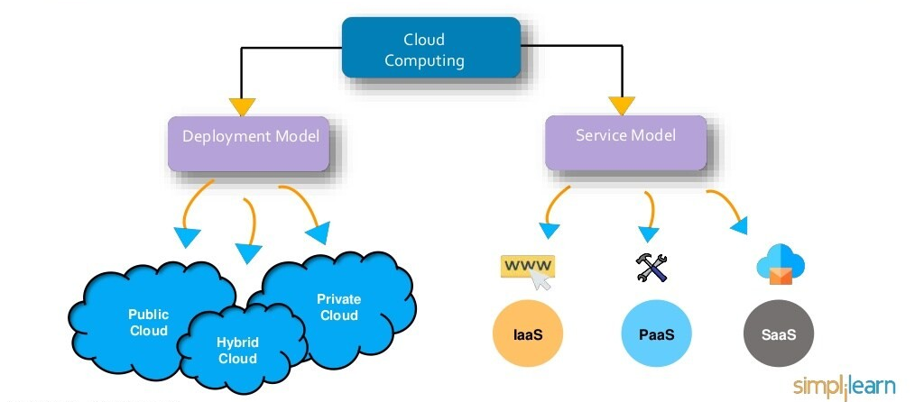
Types of Cloud Computing

Slide 17
Deployment Models

Slide 18
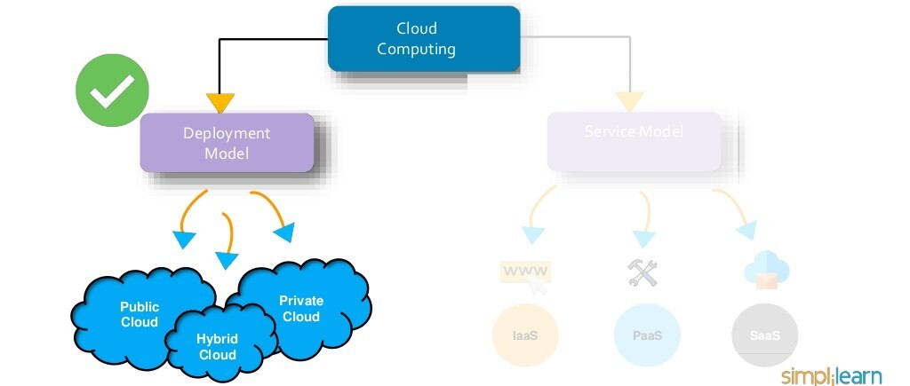
Deployment Models

Slide 19
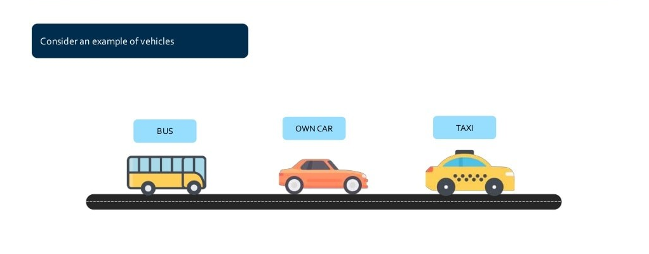
Types of Deployment Models

Slide 20
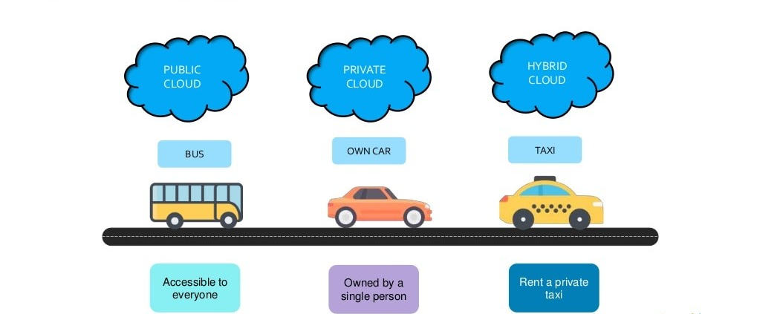
Types of Deployment Models

Slide 21
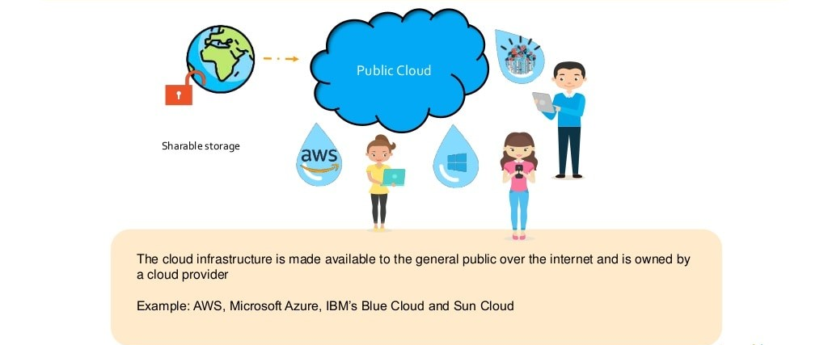
Public Cloud

Slide 22
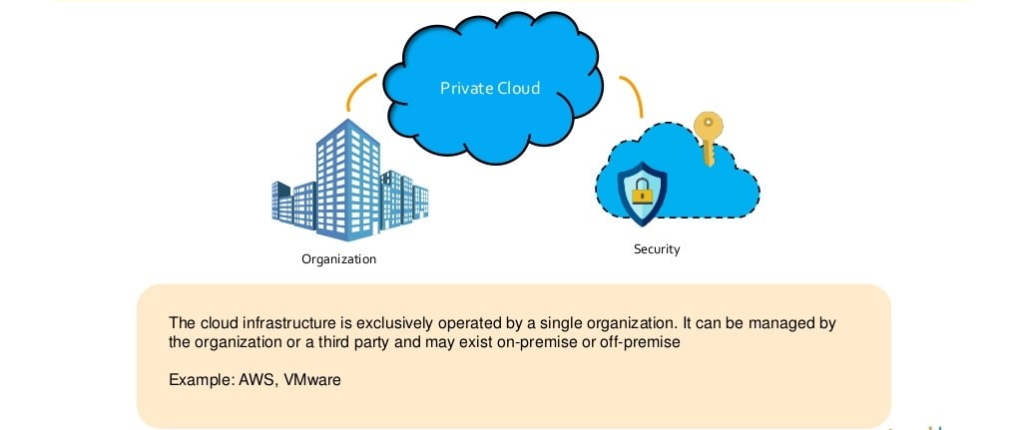
Private Cloud

Slide 23
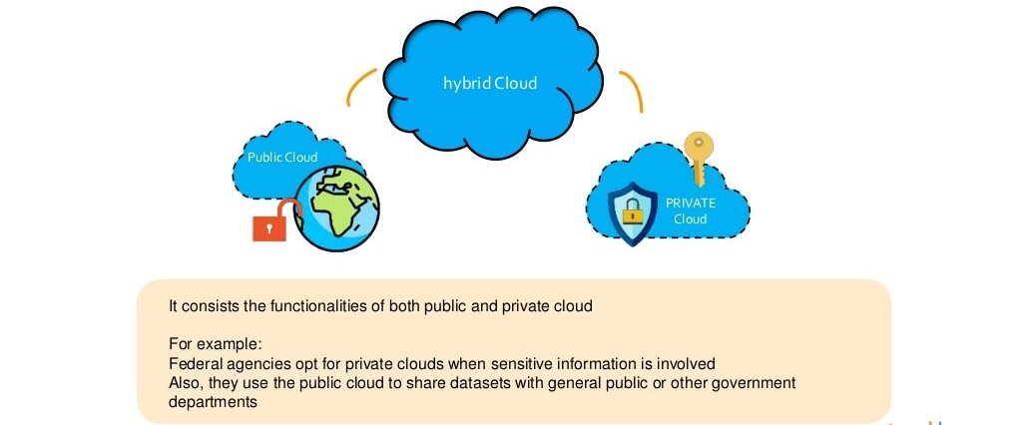
Hybrid Cloud

Slide 24
Service Models

Slide 25
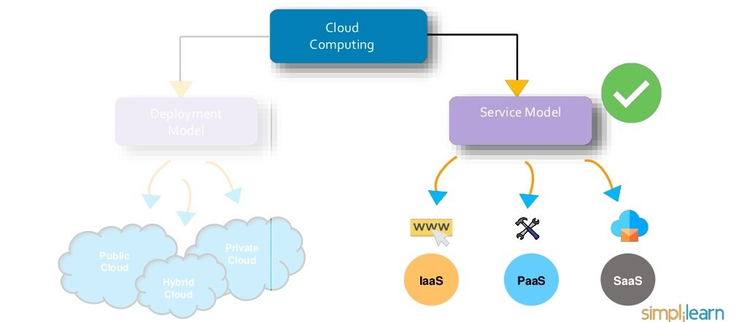
Types of Service Models

Slide 26
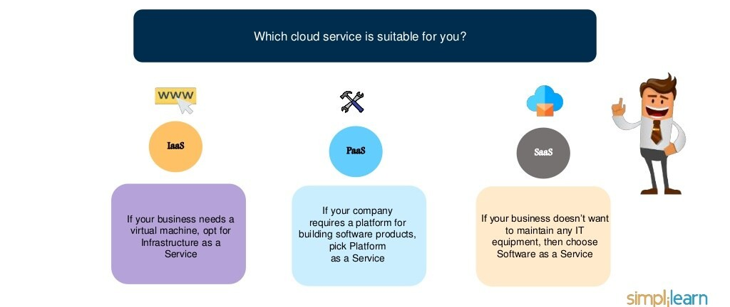
Types of Service Models

Slide 27
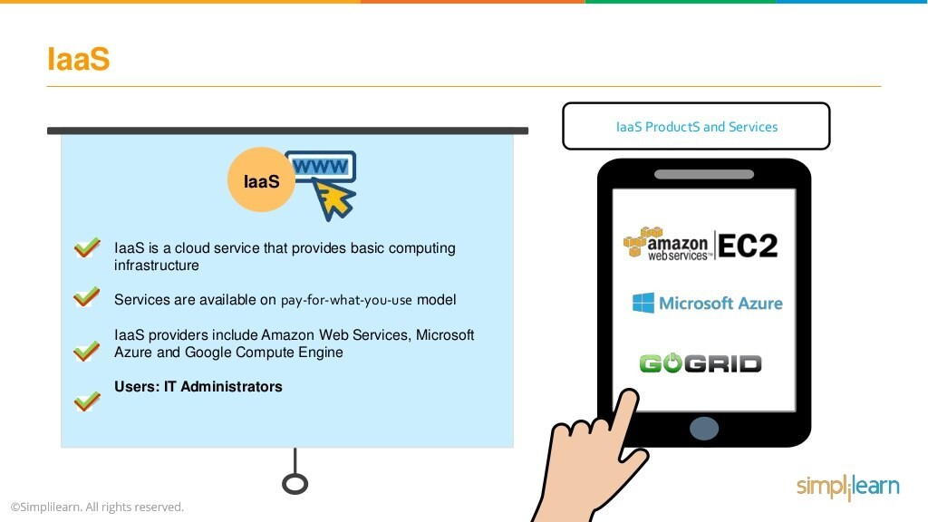
IaaS

Slide 28
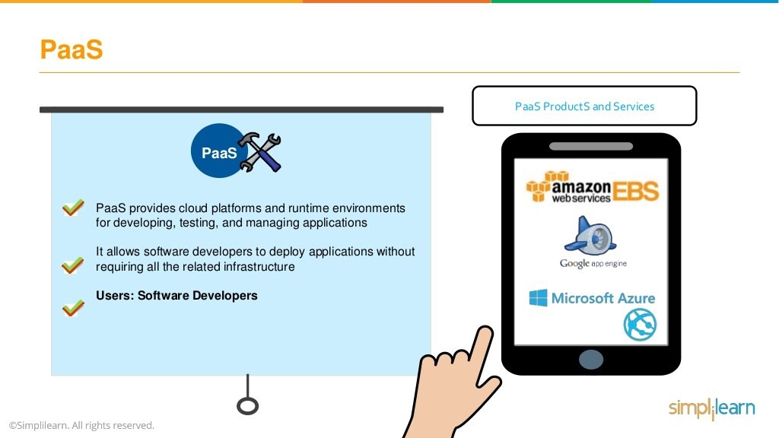

Slide 29
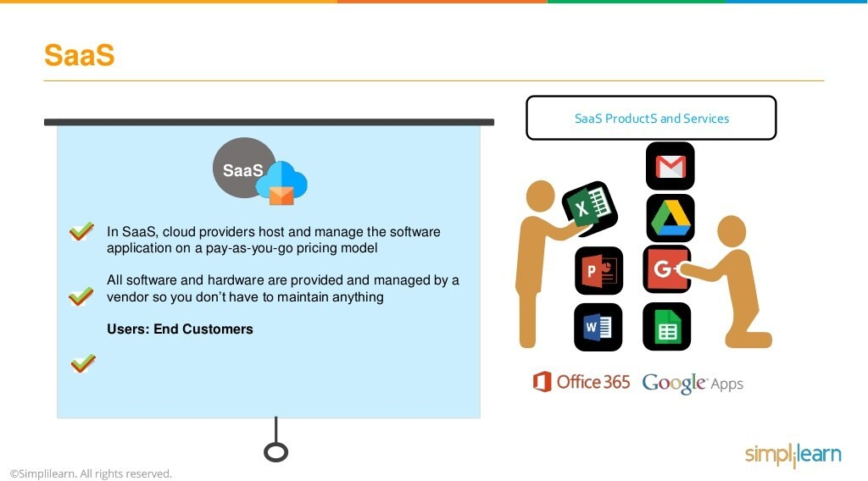

Slide 30
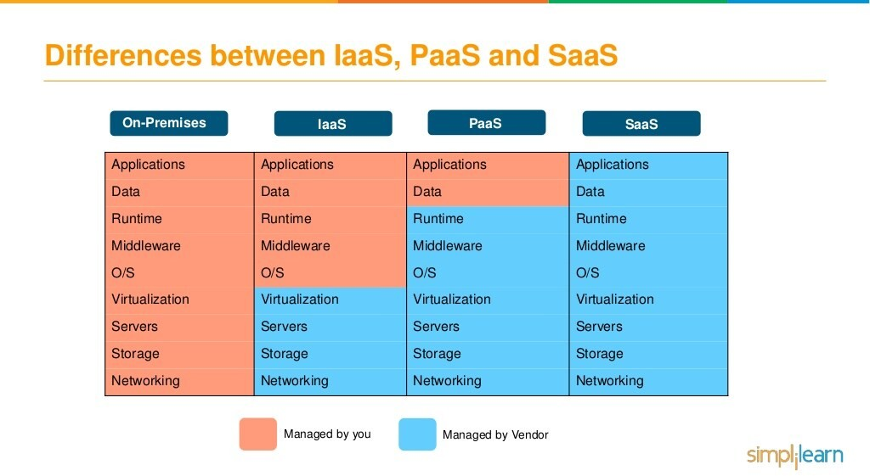

Slide 31
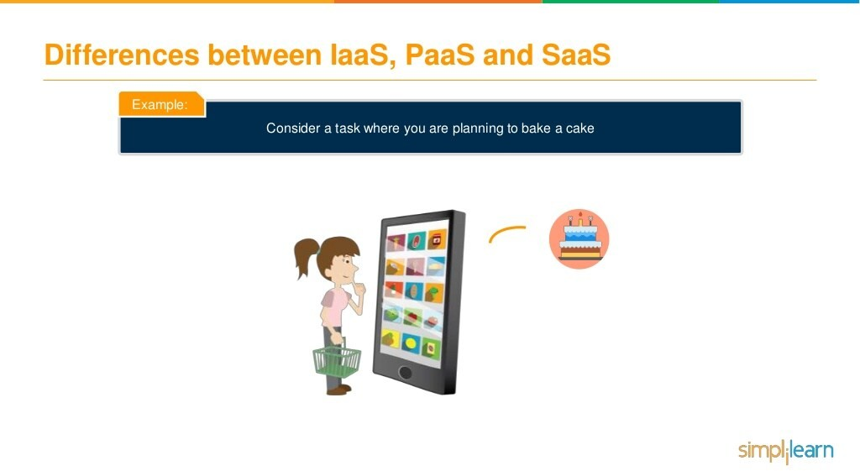

Slide 32
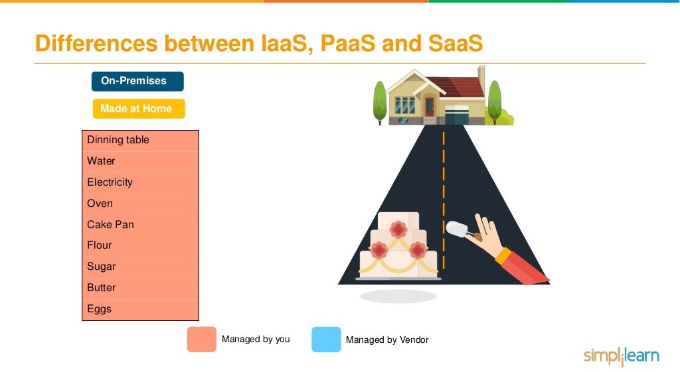

Slide 33
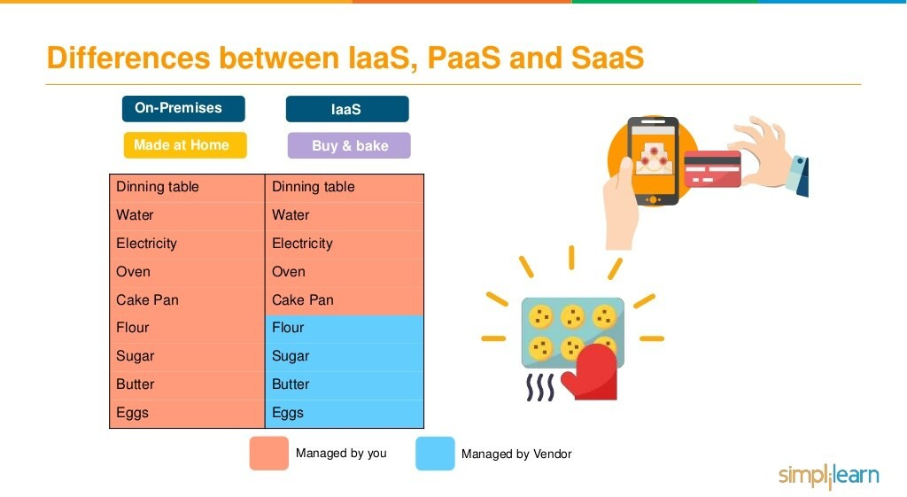

Slide 34
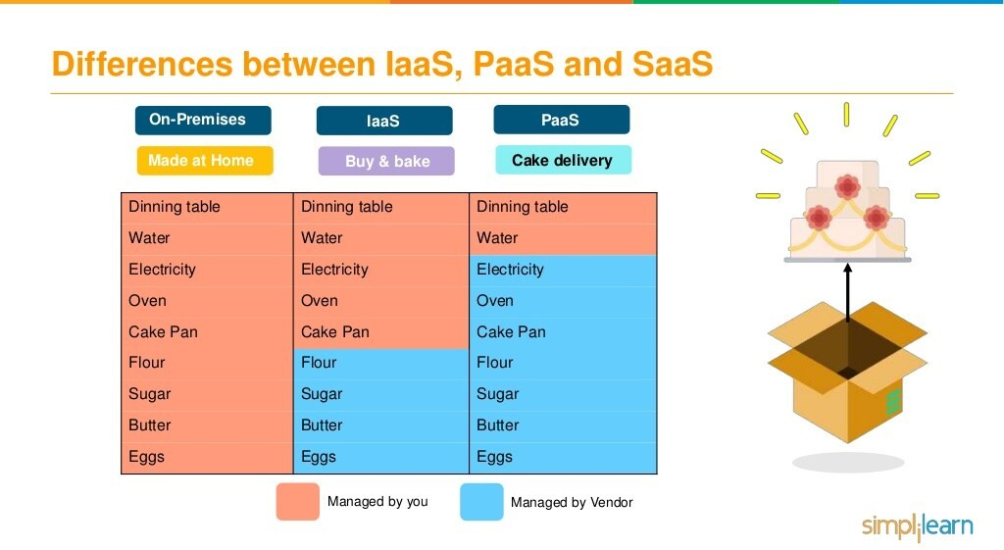

Slide 35
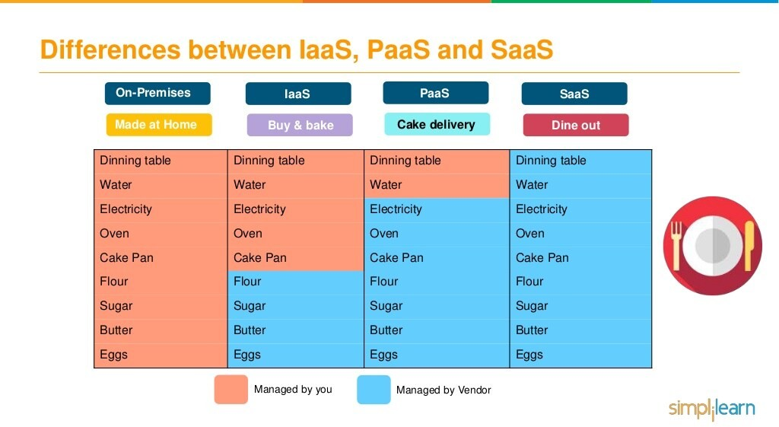

Slide 36
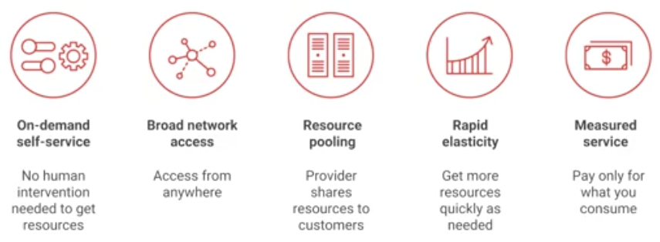
Essentials Characteristics of Cloud Computing

Slide 37
Common Characteristics
Massive Scale
Resilient Computing
Homogeneity
Geographic Distribution
Virtualization
Service Orientation
Low Cost Software
New Cloud Programming Paradigms: MapReduce/Hadoop, NoSQL/Cassandra/MongoDB and many others

Slide 38
Typical Computing Pattern
On & off workloads
Batch jobs
Wasted Capacity
Time to market can be cumbersome
On and Off
Inactivity
Period
Compute
Time
Notes:
Notes:
This slide and the next three show typical computing patterns of enterprise organizations. In-house resources are often detrimentally affected by these patterns of usage. These computing patterns illustrate the advantages of organizations moving to cloud computing services to meet their IT resource requirements.
On and off workloads (e.g., batch jobs):Over-provisioned capacity is wasted. Time to market can be cumbersome.

Slide 39
Typical Computing Pattern
Rapid Growth
Rapidly growing company
Major challenge for IT dept. to keep up with growth
Potential loss of business opportunity
Potential customer service problems
Compute
Time
Notes:
Notes:
Rapid growth:
Successful services need to grow/scale, but keeping up with growth is a major challenge for organization’s IT departments.
Often, hardware cannot be provisioned fast enough and software cannot be patched and updated as necessary.
this can lead to potential loss of business opportunities as well as customer dissatisfaction

Slide 40
Typical Computing Pattern
Unexpected peak in demand
Loss of business opportunity
Wasted capacity if demand wanes
Unpredictable Bursting
Compute
Time
Notes:
Notes:
Unpredictable bursting:
Unexpected/unplanned peaks in demand can cause sudden spikes, which impact performance.
Perhaps there is a sudden demand for a particular item. Using in-house resources, IT is unable to over-provision for extreme cases.

Slide 41
Typical Computing Pattern
Seasonal peaks and troughs
Provisioning dilemma
Wasted capacity or
Loss of business
Predictable Bursting
Compute
Time
Notes:
Notes:
Predictable bursting: Services may have micro-seasonality trends, experiencing peaks due to periodically increased demand.
This adds to IT complexity and results in wasted capacity.
This pattern is very challenging for management and the IT department since both hardware/software resources as well as human resources to manage these additional resources are necessary.

Slide 42
Cloud Computing Examples
A large enterprise quickly & economically deploys new internal applications to its distributed workforce.
An e-commerce website accommodates sudden demand for a “hot” product caused by a viral buzz.
A pharmaceutical research firm executes large-scale simulations using computing power provided by cloud vendors.
A media company serves unlimited video, music, and other media to their worldwide customer base.
Notes:
Notes:
These are all different scenarios in which cloud computing becomes necessary for efficiency.
Walmart’s OneOps is a great example of this exact principle. MS Azure allows for the same flexibility.
The second example (viral buzz) provides a great example of why paying only for what you use is useful
Cloud computing has a built in scalability that is impossible to replicate in your own servers,
you cannot change your hardware rapidly enough to accommodate something like viral buzz
Cloud computing allows you to scale up and down as needed
It is very useful to run simulations using cloud computing, you can have dozens of cores simultaneously running your simulations making the process incredibly fast
Cloud computing’s scalability really allows global applications
There must be a server within the vicinity that allows the service to host and stream their content to the user. Without this, the company would loose customers for disappointing streaming speeds and unreliability.

Slide 43
Cloud Computing Nutshell
End-users connect over the Internet to the cloud from their own personal computers or portable devices in order to access services.
To the end-user, the underlying infrastructure such as the hardware, operating system, etc., is invisible
Servers
Laptops
Desktop
Application
Platform
Infrastructure
Phones
Tablets
Cloud Computing
Notes:
Notes:
This slide summarizes many of the subjects we have discussed so far.
Reiterates the three service models and the services provided by each, as well as the different ways the cloud can be accessed.
Cloud Computing: (Events in / properties of)
Application:
Monitoring
Content
Collaboration
Communication
Finance
Platform:
Object Storage
Identity
Runtime
Queue
Database
Infrastructure
Compute
Block Storage
Network

Slide 44
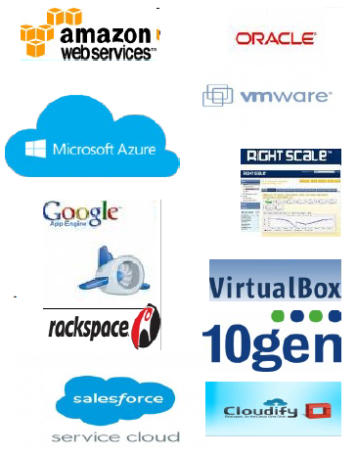
Many Cloud Providers
AWS: Amazon Web Services
EC2: Elastic Compute Cloud
S3: Simple Storage Service
EBS: Elastic Block Storage
Microsoft Azure
Google Compute Engine/AppEngine
Rightscale, Salesforce, EMC,
Gigaspaces, 10gen, Datastax, Oracle,
VMWare, Yahoo, Cloudera
And 100s more…

Slide 45
Cloud-Sourcing
Why is it becoming important?
Using high-scale/low-cost providers,
Any time/place access via web browser,
Rapid scalability; incremental cost and load sharing,
Can forget need to focus on local IT.
Concerns:
Performance, reliability, and SLAs,
Control of data, and service parameters,
Application features and choices,
Interaction between Cloud providers,
No standard API – mix of SOAP and REST!
Privacy, security, compliance, trust…

Slide 46
Advantages of Cloud Computing
Lower computer costs
No need of a high-powered and high-priced computer to run cloud computing's web-based applications
Improved performance
Cloud computing system boot and run faster because they have fewer programs and processes loaded into memory
Reduced software costs
No need to purchase expensive software applications

Slide 47
Advantages of Cloud Computing
Instant software updates
Unlimited storage capacity
Increased data reliability (crash of hard drive destroy valuable data)
Universal information access
Latest version availability
Easier group collaboration
Device independence

Slide 48
Disadvantages of Cloud Computing
Requires a constant internet connection
Does not work well with low-speed connections
Features might be limited
Application Can be slow
Stored data might not be secured
Stored data can be lost!
Not clear that you can run compute-intensive HPC applications that use MPI/OpenMP
General Concerns
Each cloud systems uses different protocols and different APIs
may not be possible to run applications between cloud based systems
Amazon has created its own DB system (not SQL 92), and workflow system (many popular workflow systems out there)
so your normal applications will have to be adapted to execute on these platforms.

Slide 49
Thank you!
Any Questions???

